Slide 1
Charity Organization Society & Settlement House Movement
Dr. Imran A. Sajid
DSW| UOP
imranahmad131@uop.edu.pk
Adopted from Prof. Amir Zada Asad, PhD, Hull UK
Based on Walter Friedlander, Introduction to Social Work and Social Welfare

Slide 2
HISTORICAL DEVELOPEMNT OF MODERN SOCIAL WORK PROFESSON
The roots of modern social work and social welfare are based on religious ideologies and can be traced back to the socio-economic conditions of Europe and America during the second half of the 19th Century.
Two movements became the harbingers of modern social work in the West namely, the COS, and the Settlement House Movement.

Slide 3
01. Charity Organization Society

Slide 4
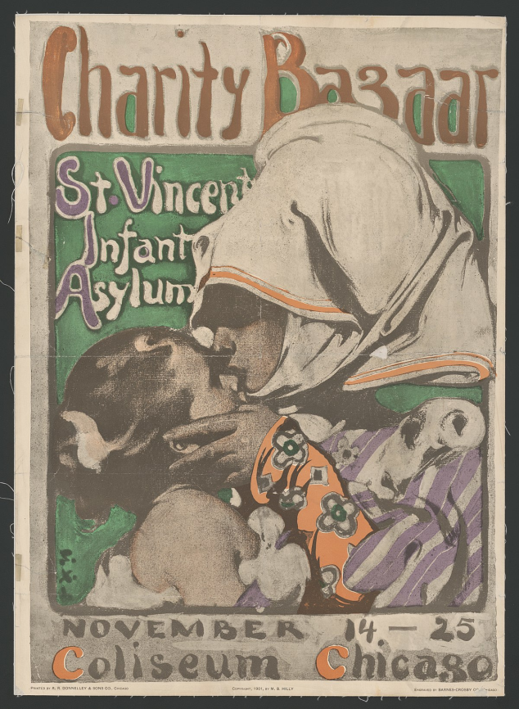
During this period in England in particular, due to mass unemployment, poverty and the role of the industrialist due to the prevalent economic ideology of “Laissez faire” the working class was the major sufferer.
In order to help the poor and hungry people many charitable societies for philanthropic purposes were established.
In newspapers donations were solicited.
In London almost every church was colleting donations and distributed food, clothing, alms and fuel tickets among the needy

Slide 5
These charitable societies faced the usual criticism that they are encouraging beggary and dependence and wasting money on sturdy beggars.
Many critics considered the poverty as a personal failure of the poor

Slide 6
CHARITY ORGANIZATION SOCIETY C.O.S.-1869
In order to overcome this chaos of confrontation between the charities and the society, clergyman Rev. Henry Solly, in 1868, suggested the establishment of a board to coordinate the activities of all the private and public charities.
In 1869, “The society for Organizing Charitable relief and Repressing Mendicity ” was founded in London.
Soon it became to be known as “Charity Organization Society” or COS.

Slide 7
COS had Four Major principles:
The society believed that the individual was responsible for his poverty and that
acceptance of public assistance destroyed the self-respect of the pauper and
led him to subsists on alms.
The society also pressed for the education of the paupers to exert all their abilities for maintaining self.

Slide 8
STRATEGY
01. COS set-up an enquiry department where the poor Law guardians, charity societies, and individual philanthropists were provided information about applications for relief.
This innovation unmasked many professional beggars who were registered for relief at different places.

Slide 9
02.
The COS also divided every city into small districts each headed by a group of volunteer citizens, mostly the well-to-do people.
They used to help the families with money, clothes, alms, food etc but the main emphasis was on the moral rehabilitation so that they can initiate to support themselves.
03.
COS was opposed to provide relief to the poor for a long period and tried to enable them to be self-supporting.

Slide 10
04.
COS had information on all the social services available within the community.
Soon it became a hub of referral to social services

Slide 11
This was the beginning of modern professional social work i.e.
social case work as individual aid, and
community Organization (Organizing the community to help own people) in England in1869 onward.
This practice spread to other cities of England and Scotland.

Slide 12
This was the individualized/ person-centered approach which have become the central tenets of social work practice or better to call it modern social case work practice.
Notes:
This approach was taken to USA by another clergy-man Joseph Tuckerman in 1819 who started such activities in Boston USA.

Slide 13
Modern Social Work In USA
COS movement is widely recognized as the parent of organized social work, began in 1869 in England and in 1877 in USA.
Another clergy-man Humphreys Gurteen, took the same practice to Buffalo , New York.
Gurteen was moved by the appalling poverty in USA and the relief system to help the poor.

Slide 14
He went to London and studied the work of COS.
He was impressed with the work and returned to New York and started the same method of relief there.
His system emphasized the investigation of each individual case and coordination of the activities of all the charities to avoid duplication of services.
This was the start of modern social work (case work & com. Dev) in USA.
COSs considered themselves more than just alms givers. Their ultimate goal was to restore as much self-sufficiency and responsibility as an individual could manage, i.e. Social Casework.

Slide 15
The first social work school
Many COS established co-operatives stores for the poor, community organizations helping in housing problems, and curtailing child labor.
The NY COS began its own publications, founded the first summer school of Applied Philanthropy in New York in 1898, which became the first full-fledged School of Social Work (Now the Columbia University school of Social work) in 1908.

Slide 16
Settlement House Movement

Slide 17
Summary
1886, an American, Stanton Coit, New York
1889, Jane Adams, Chicago, Hull House
03 Milestones of Hull House
Ethical Principles of Hull House
Main Idea of Hull House
Source of Problem
Use of Group work and Community Organization
Use of Social Research and Advocacy
1867 Edward Denison
1873 Canon Samuel Augustus Barnett
Barnett’s Idea
Connect University with Community
1883 Toynbee Hall
Functions/Objectives of Toynbee Hall
Education and Cultural development of the poor.
Information for the students and other residents of the settlement regarding the conditions of the poor and the urgent need for the social reforms.
A general awakening of popular interest in health and other social problems, and social legislation.
Toynbee hall acted as a laboratory for experimenting new ideas of poor rehabilitation.

Slide 18
2. THE SETTLEMENT HOUSE MOVEMENT AND MODERN SOCIAL WORK
In 1880s another movement to tackle poverty was taking place in England. This was the Settlement* House Movement.
Edward Denison, a Christian Socialist took a new direction in helping the poor to get education.
Denison was convinced that mere distribution of alms could not change the fate of the poor unless they are brought at par with other sections of the society through education.
* 1. Small Community
2. a public building in which social workers provide services to an underprivileged area, especially an urban area

Slide 19
In 1867, he moved into the poor area of Stephaney, East London and lived with them.
Denison taught bible, Economics and History to the locals.
The local found him reluctant to give them food and alms unless he was certain about their needs.

Slide 20
This idea of living with communities in need was most effectively demonstrated by Canon Samuel Augustus Barnett.
He was appointed as Vicar of St. Jude’s church in White chapel east London, in 1873.
He found that of the 8,000 population of the parish, most people were
sick,
unemployed, and
lived in filthy conditions, and
over crowded tenements.

Slide 21
BARNETT’S IDEA
Barnett’s idea was that University people were cut off from the real work of the world.
He went to Oxford and Cambridge and discussed this situation with the students.
He invited them to live with the people and know the real conditions of the poor people, and help them educate.
Barnett converted his parish into a Neighborhood Center or Community center, where the university students lived and worked with the families.

Slide 22
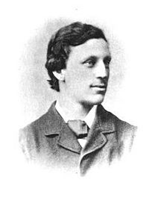
Among the University students was one man Arnold Toynbee who took much interest in this work of rehabilitation of the poor.
In 1883, Arnold caught TB there and died.
In his memory the community center was named as Toynbee Hall.
It was the first Settlement House in the world.
Arnold Toynbee
1852-1883)

Slide 23
Objectives/Functions of Toynbee Hall
Toynbee Hall had three main objectives;-
Education and Cultural development of the poor.
Information for the students and other residents of the settlement regarding the conditions of the poor and the urgent need for the social reforms.
A general awakening of popular interest in health and other social problems, and social legislation.
Toynbee hall acted as a laboratory for experimenting new ideas of poor rehabilitation.

Slide 24
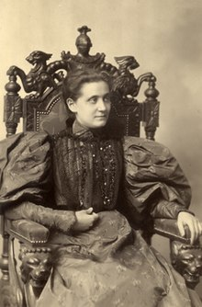
SETTLEMENT HOUSES IN USA
The Settlement house experience was much praised the world over for its effectiveness.
In 1886, an American, Stanton Coit, who had just finished his Ph.D. from Germany, visited Toynbee Hall and was impressed with the working.
He returned to New York and established the neighborhood Guild, first settlement house in USA.
Jane Adams visited Toynbee Hall in 1888 and returned to Chicago to found the Hull house.
Mother of Social Work
Charles Jerald Hull

Slide 25
MILESTONES ACHIEVED BY HULL HOUSE
Jane Adams established a school for the children of immigrants at Hull House.
Within a few years, children of immigrants from varying backgrounds were Americanized.
Residents of Hull-house conducted investigations on housing, midwifery, fatigue, tuberculosis, typhoid, garbage collection, cocaine, and truancy
Other facilities included
a night school for adults,
clubs for older children,
a public kitchen,
an art gallery,
a gym,
a girls' club,
a bathhouse,
a book bindery,
a music school,
a drama group and a theater, apartments,
a library,
meeting rooms for discussion, clubs,
an employment bureau, and a lunchroom
Social Group Work
Group Work
Community Organization and Development
Social Work Research

Slide 26
Jane Addams developed three "ethical principles" for social settlements:
to teach by example,
to practice cooperation, and
to practice social democracy, that is, egalitarian, or democratic, social relations across class lines

Slide 27
The main Idea of the settlement house
The main idea and work of the settlement houses was to combine social advocacy and social services to respond to the social disorganization that resulted from widespread industrialization and urbanization and the large influx of migrants of all kinds.
Social Problems

Slide 28
Sources of Problems
Activist in the movement were concerned with the deplorable social conditions under which individuals lived, and they defined problems environmentally, looking after the socio-economic needs of the individuals.

Slide 29
The Use of Group Work , Community Organization, Social Research and Advocacy
Through group work and neighborhood organizing strategies/Community development the workers of the Settlement house established neighborhood centers and offered services such as citizenship training , adult education, counseling, recreation, inter-cultural exchange, and day-care.
Through research and political advocacy the workers supported legislative reforms in child welfare, housing reforms, labor laws, and public health and sanitation.

Slide 30
Difference Approaches
COS
SHM
Individual is responsible for his failure
Rehabilitate individual to exert his/her full capacities to cope more effectively with the problems in his/her social functioning
Moral rehabilitation is the key strategy
Social casework and Community organization
Social conditions are responsible for individual poverty and other social problems.
Research and political advocacy as effective tools to fight social problems
Education as the key strategy
Social Groupwork, Community Organization, Social Research, and Social Action

